Slide 1
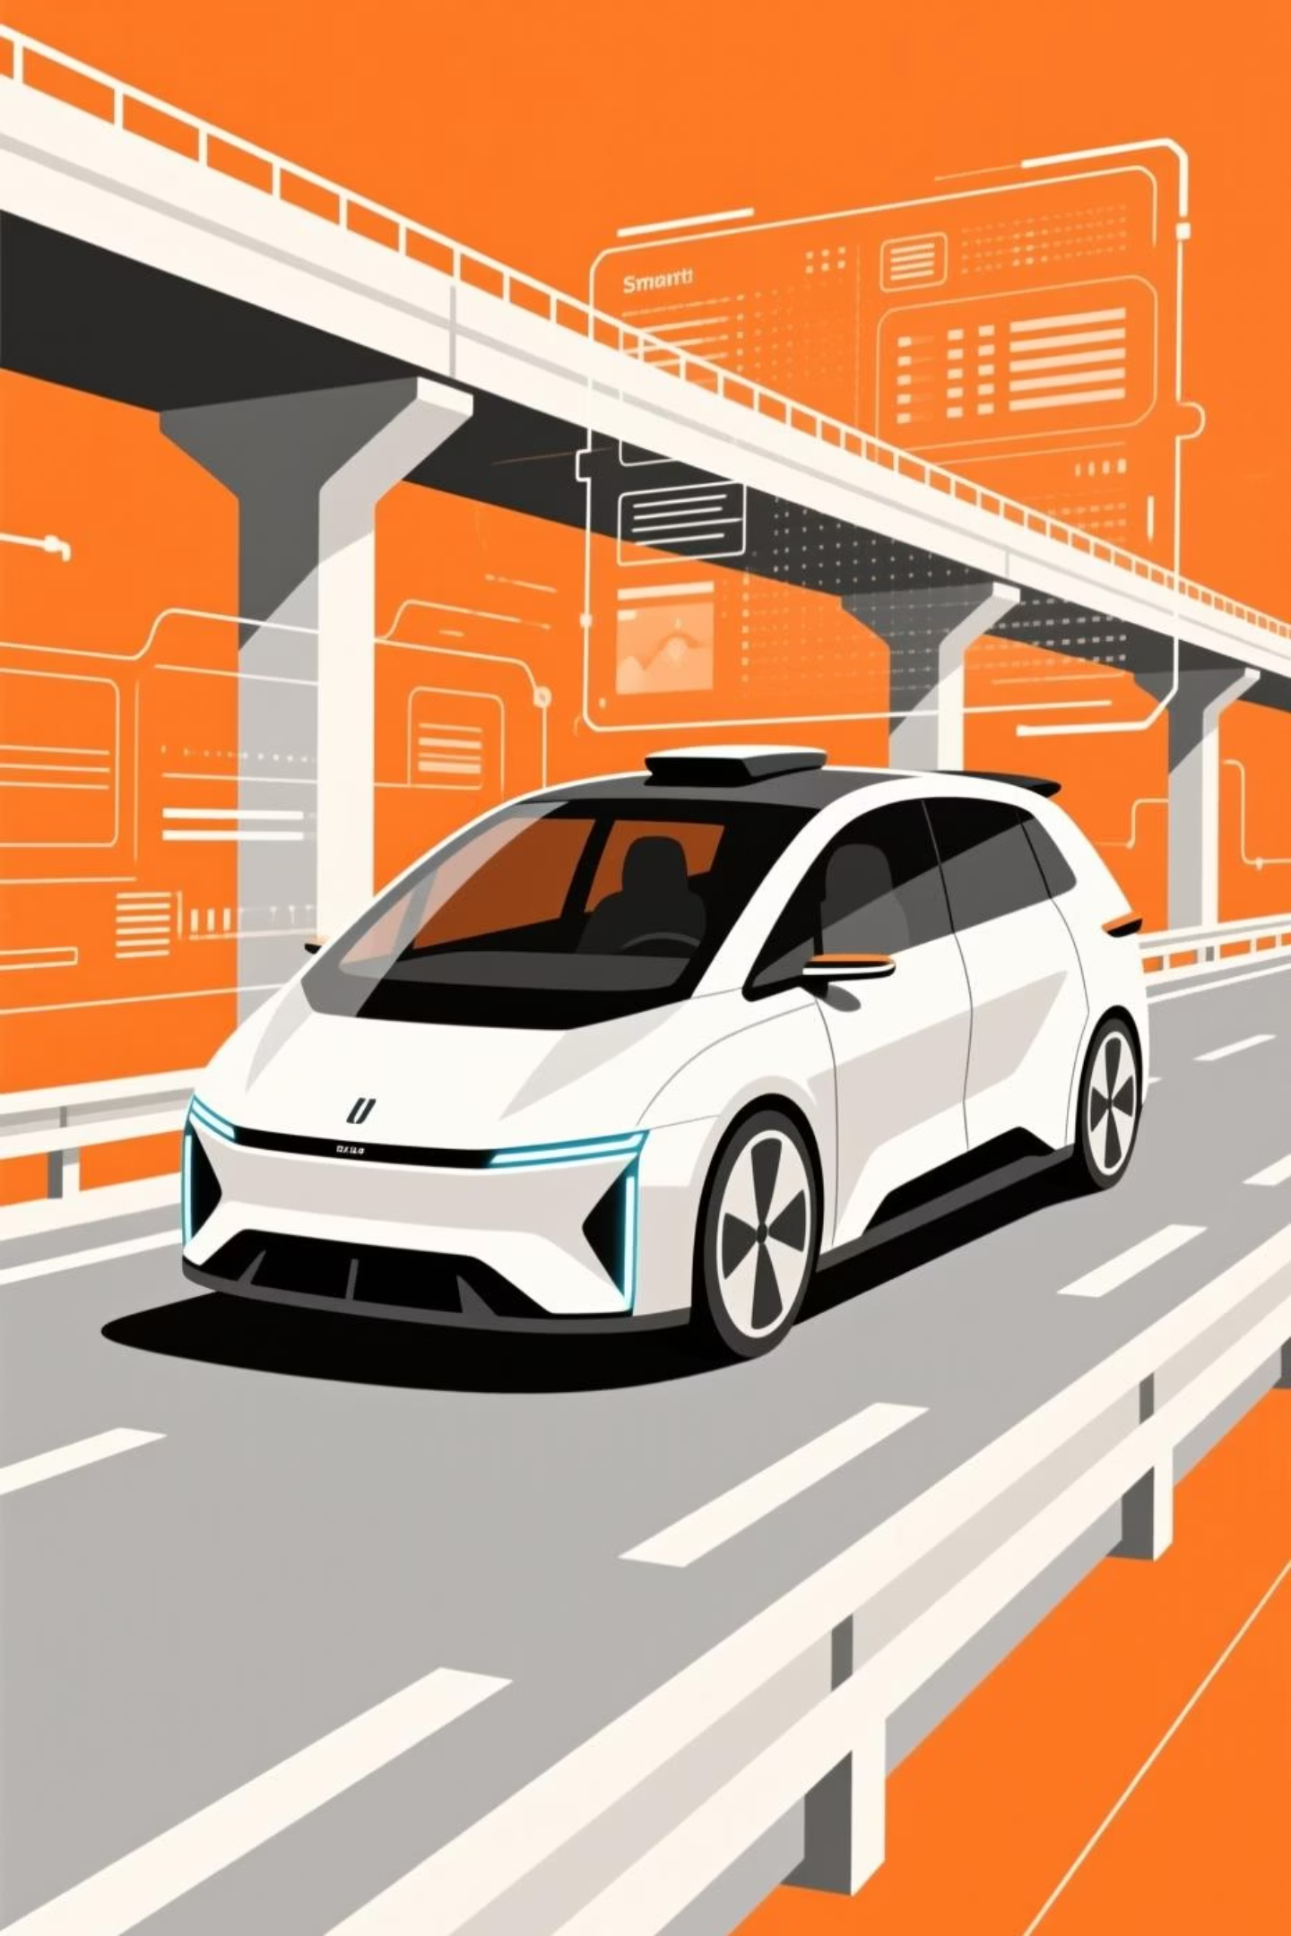
AutoSenseAI
Autonomous Predictive Maintenance and Smart Service Scheduling
Revolutionizing automotive service through intelligent agent orchestration and real-time predictive analytics.

Slide 2

Team Skills Overview
Team Skills Overview
Chinni Anjaneyulu — AI & Data Science Lead → Predictive Modeling · Voice AI · Agent Orchestration
GVS Karthikeya — AI & Robotics Engineer → Cloud Deployment · AWS · Docker
Yerasu Thejeswar Reddy — Full Stack Developer → Workflow Design · API Integration
B Sai Swaroop — Python Developer → Data Processing · Predictive Analytics
Konduru Rohan — Java Developer → FastAPI · React · Database Systems

Slide 3

Quick Introduction :
AutoSenseAI is an Agentic AI solution built for automotive OEMs to shift vehicle care from reactive to proactive.
It predicts potential failures using real-time telematics, autonomously schedules maintenance, and communicates with customers through smart voice agents.
A continuous feedback loop to manufacturing improves product quality, reduces downtime, and boosts customer trust.
“Predict. Prevent. Perform.”

Slide 4
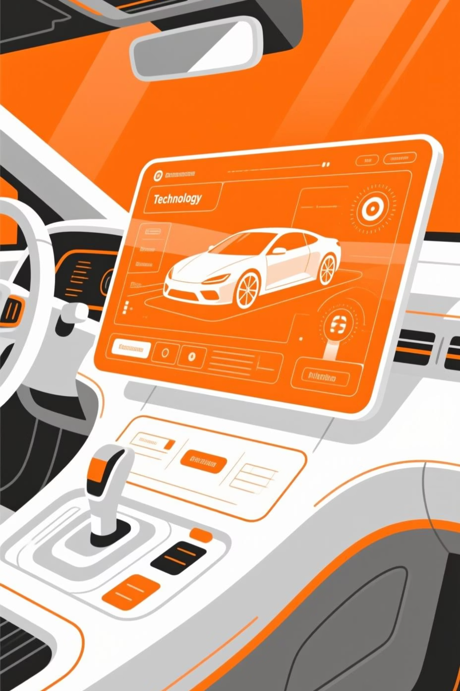
⚙️ Problem Statement :
Vehicle maintenance today is reactive and fragmented, leading to:
Unplanned breakdowns and low customer satisfaction
Inefficient scheduling and poor service center utilization
No data-driven feedback from maintenance to manufacturing
Recurring defects due to lack of RCA/CAPA automation
Why it matters:
Reduced vehicle uptime and customer loyalty
Higher operational costs from emergency repairs
Missed opportunities for design improvement
The need: An autonomous, intelligent system that predicts failures early, engages customers proactively, and creates a closed-loop feedback mechanism for continuous quality improvement.

Slide 5
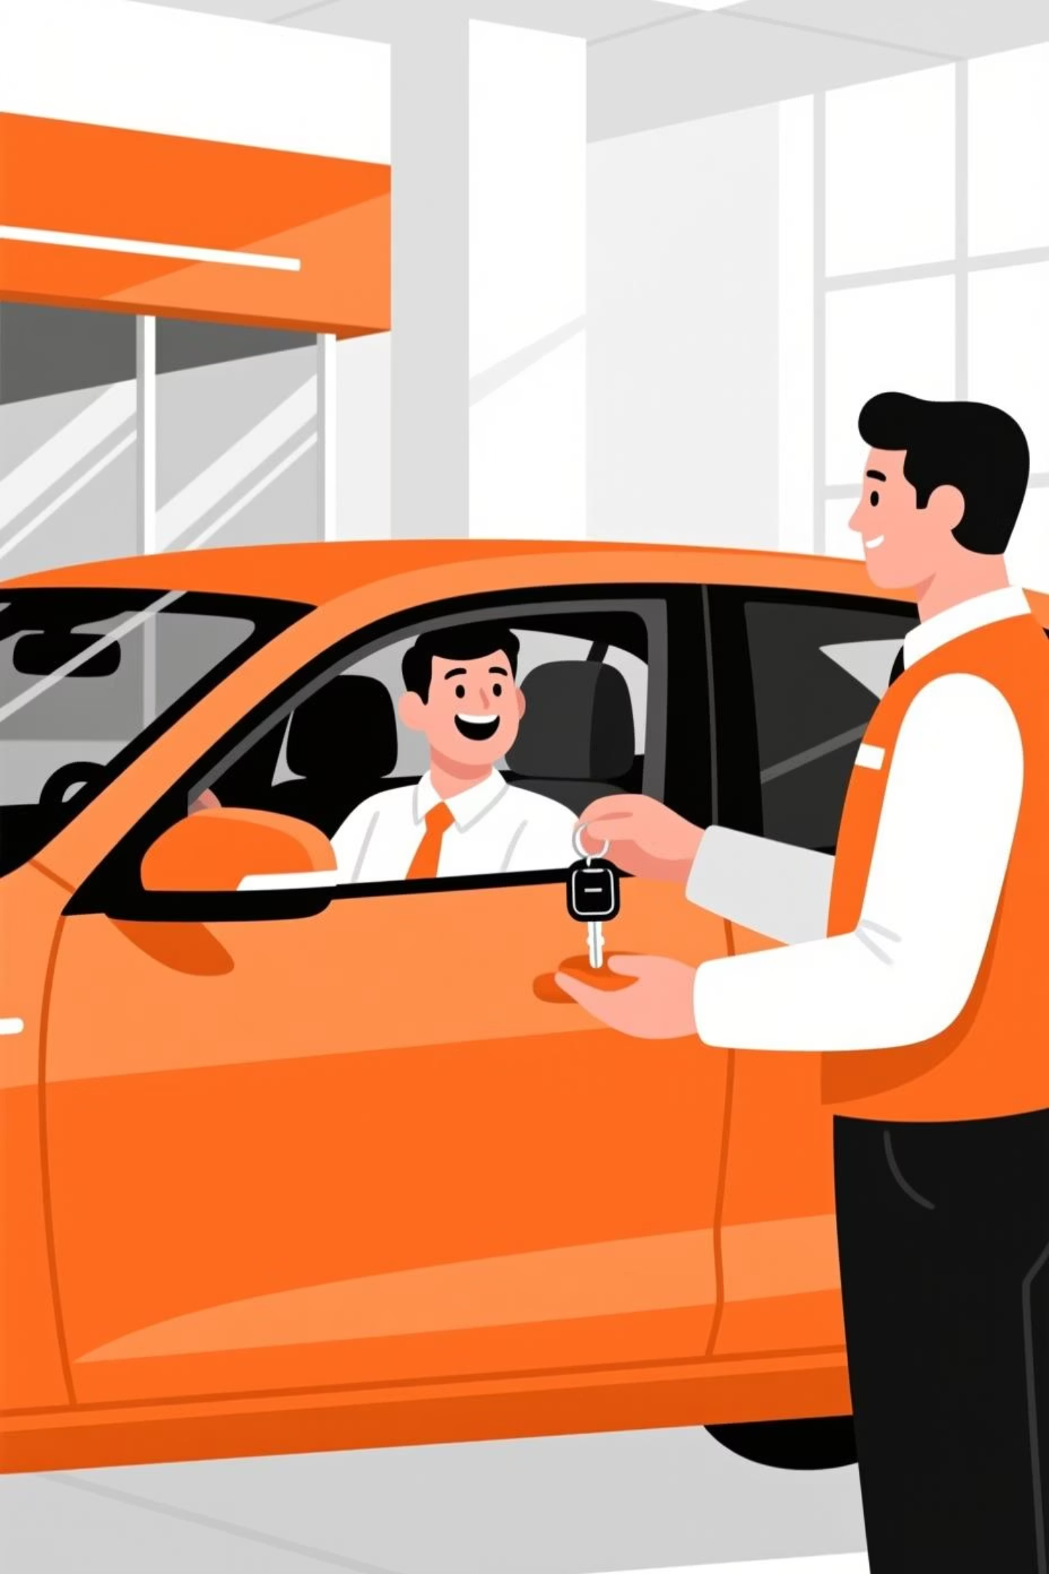

Solution Overview :
We designed an Agentic AI ecosystem where a Master Agent orchestrates multiple Worker Agents to handle prediction, diagnosis, customer interaction, and scheduling all autonomously.
Output Form Factor :
Web App Dashboard (for OEMs & service centers)
Voice Bot / Chatbot Interface (for vehicle owners)
Faceless Background Agents (for real-time data monitoring & RCA insights)
Key User Groups :
Vehicle Owners → receive alerts, book service, give feedback
Service Centers → receive predictive maintenance bookings
OEM Manufacturing Team → get RCA/CAPA-based insights for product quality
Work Flow

Slide 6
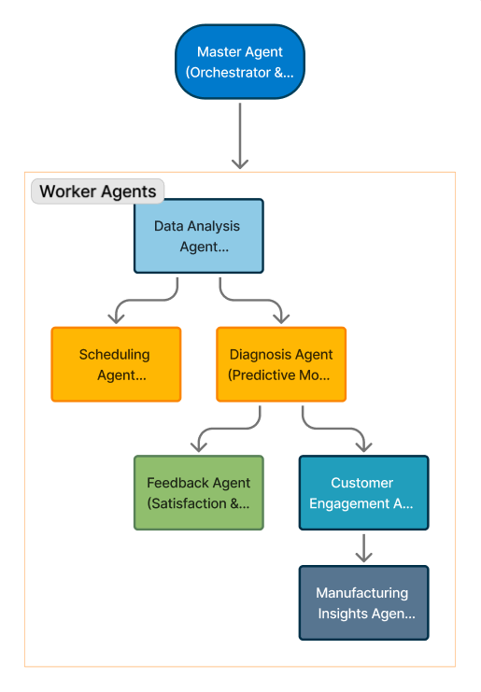
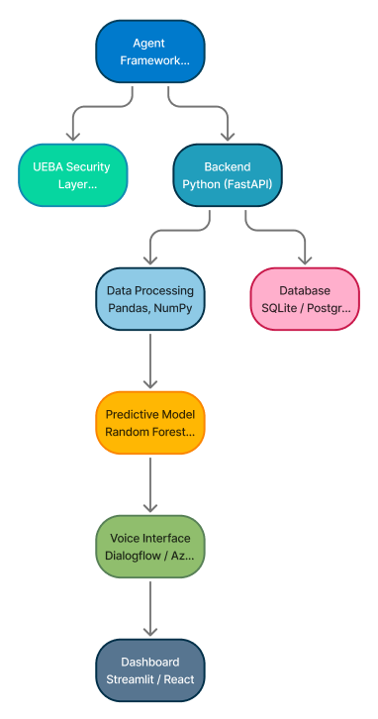
AutoSenseAI System Architecture Diagram
AutoSenseAI Technology Stack & Secure Agent Flow

Slide 7


Potential Benefits of AutoSenseAI
Insights on automotive innovation and efficiency
Business Impact
Key Metrics
Uptime improved by 40–50%
Customer satisfaction up by 30%
Utilization enhanced by 25%
Quality improved with faster feedback
Operational costs reduced by 20–30%
Prediction accuracy: >85%
Conversion rate: >70% leads
Downtime reduction: ≥40% per vehicle
Anomaly detection: 100% success rate

